Slide 1


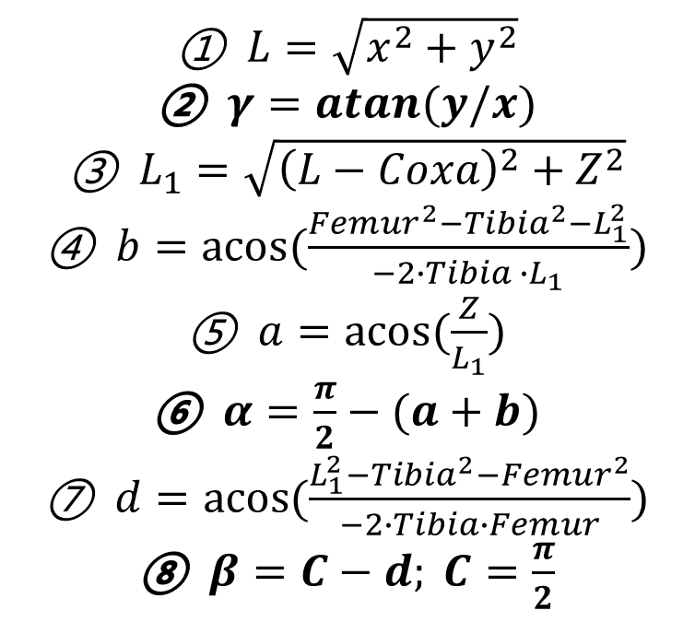

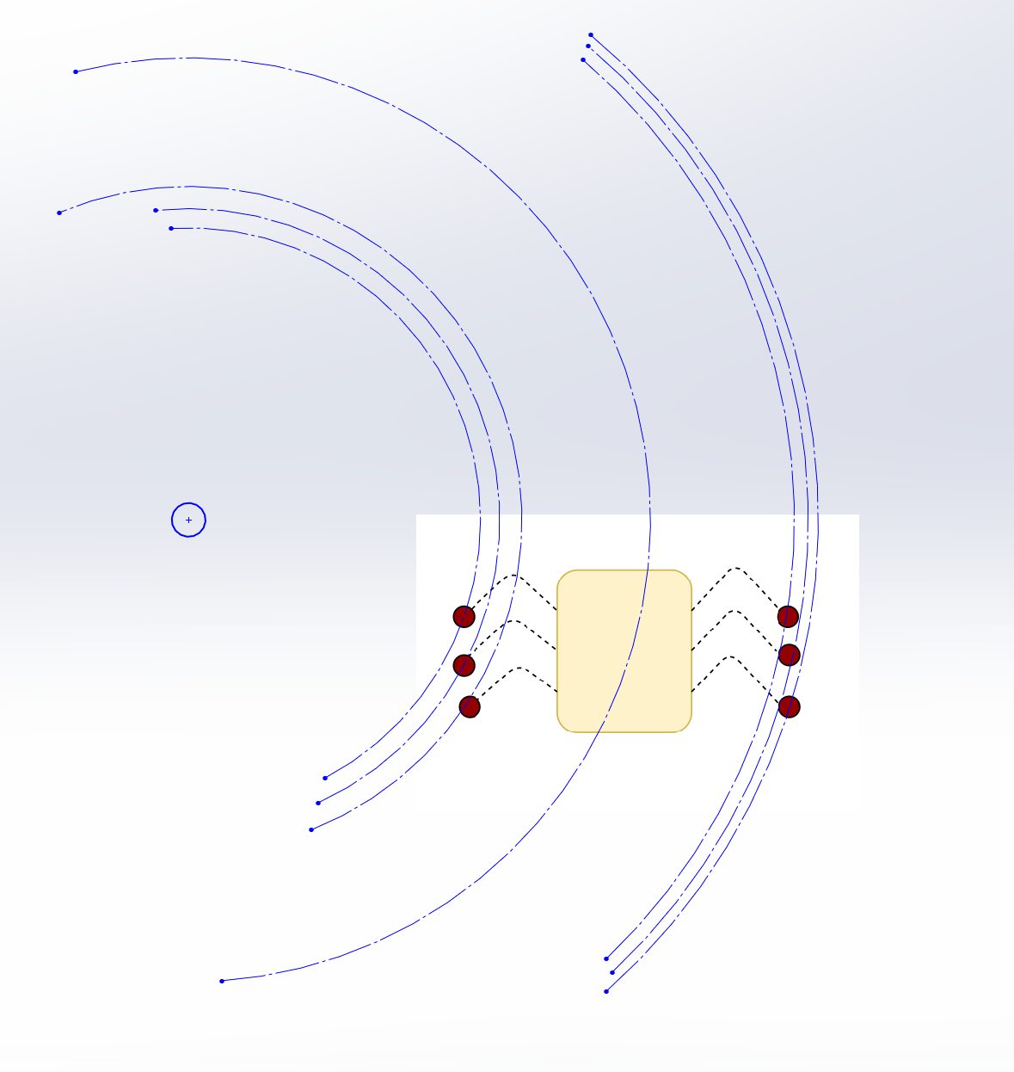
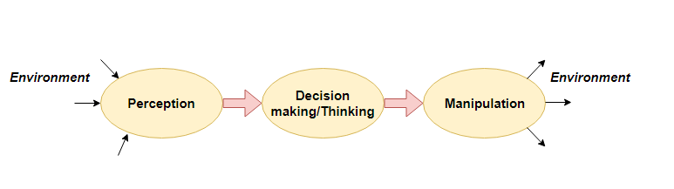
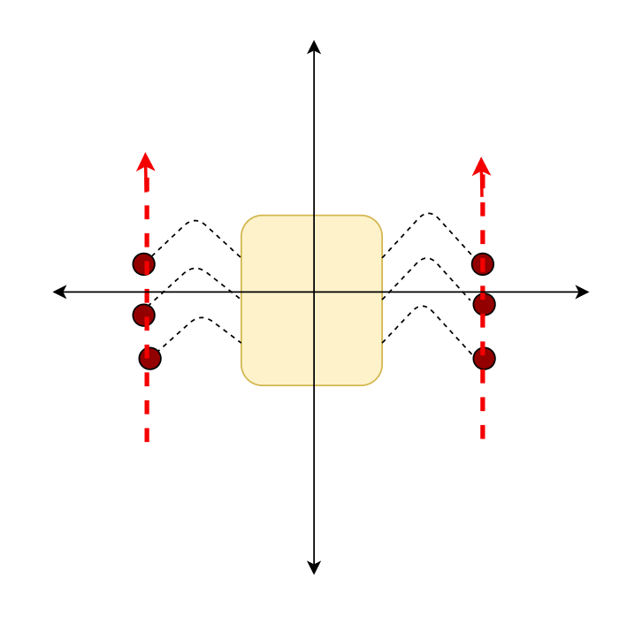
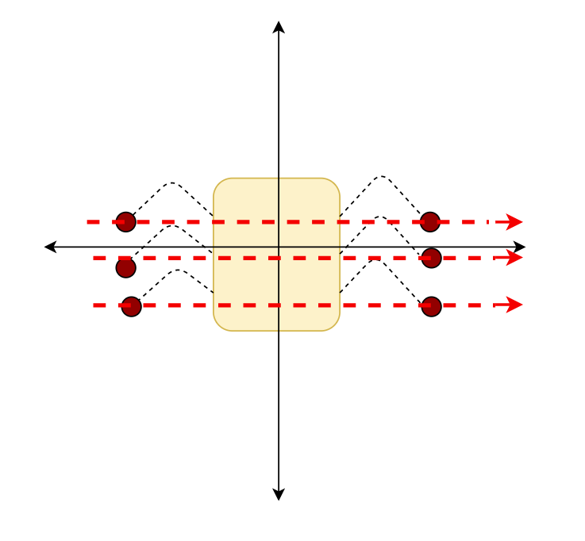
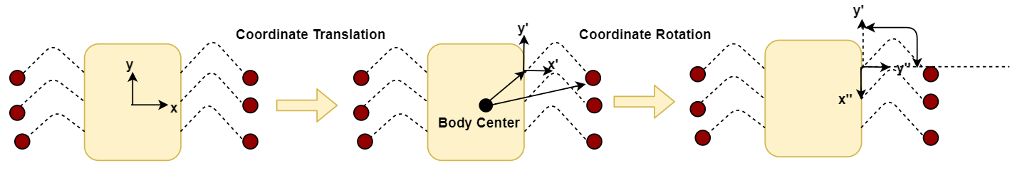









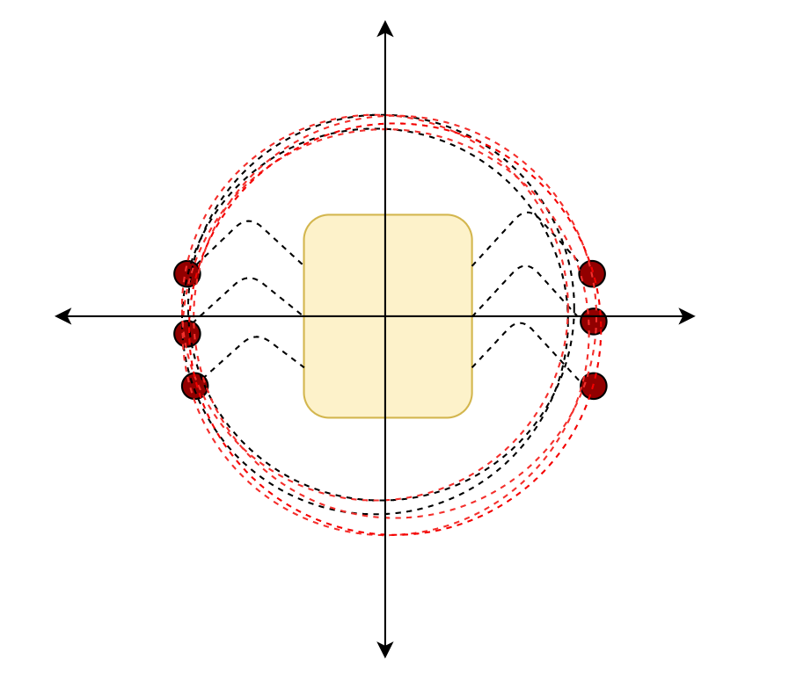
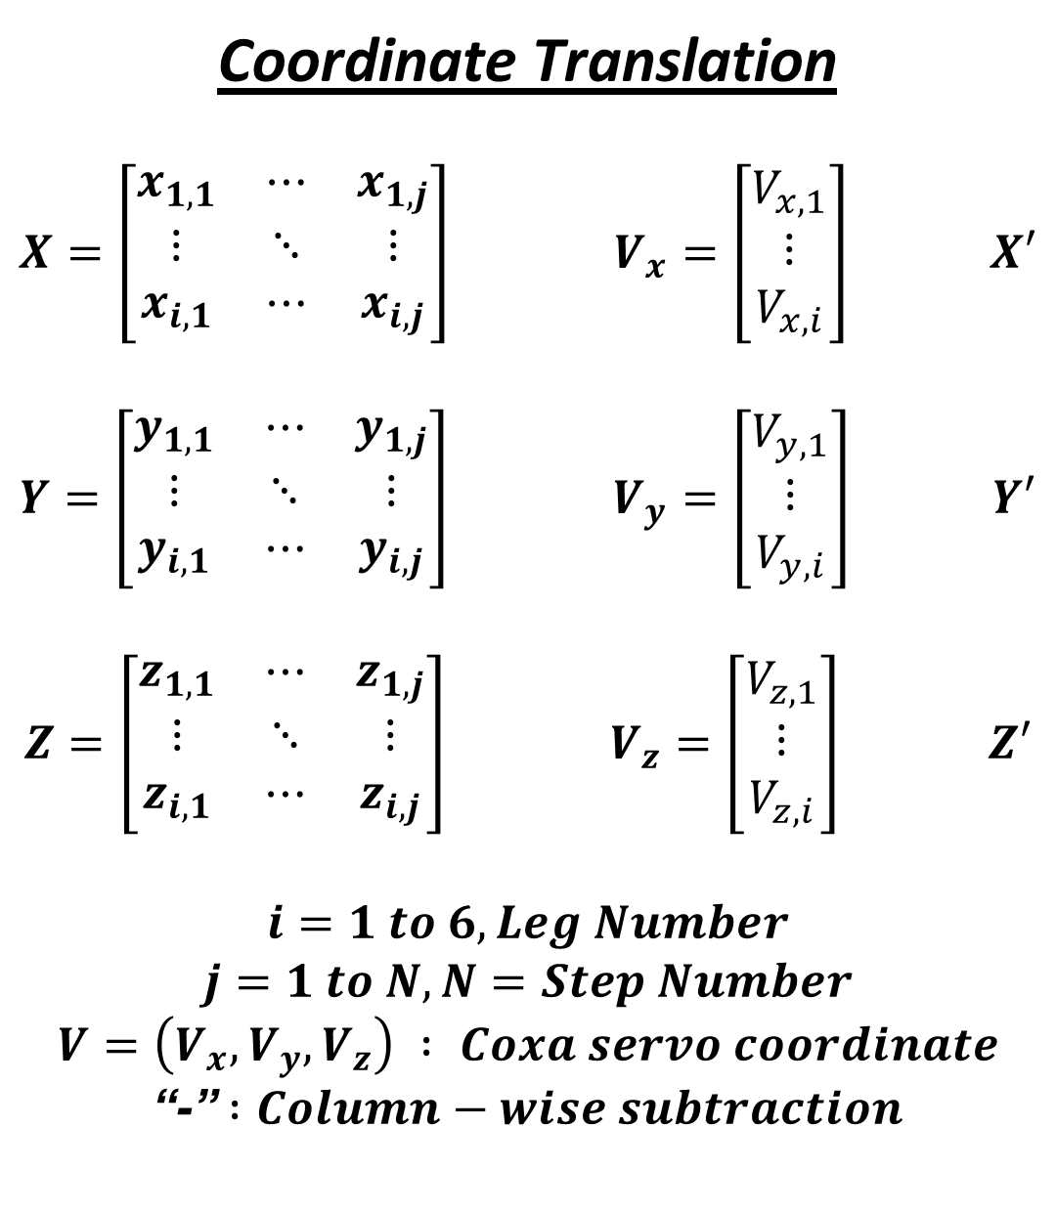
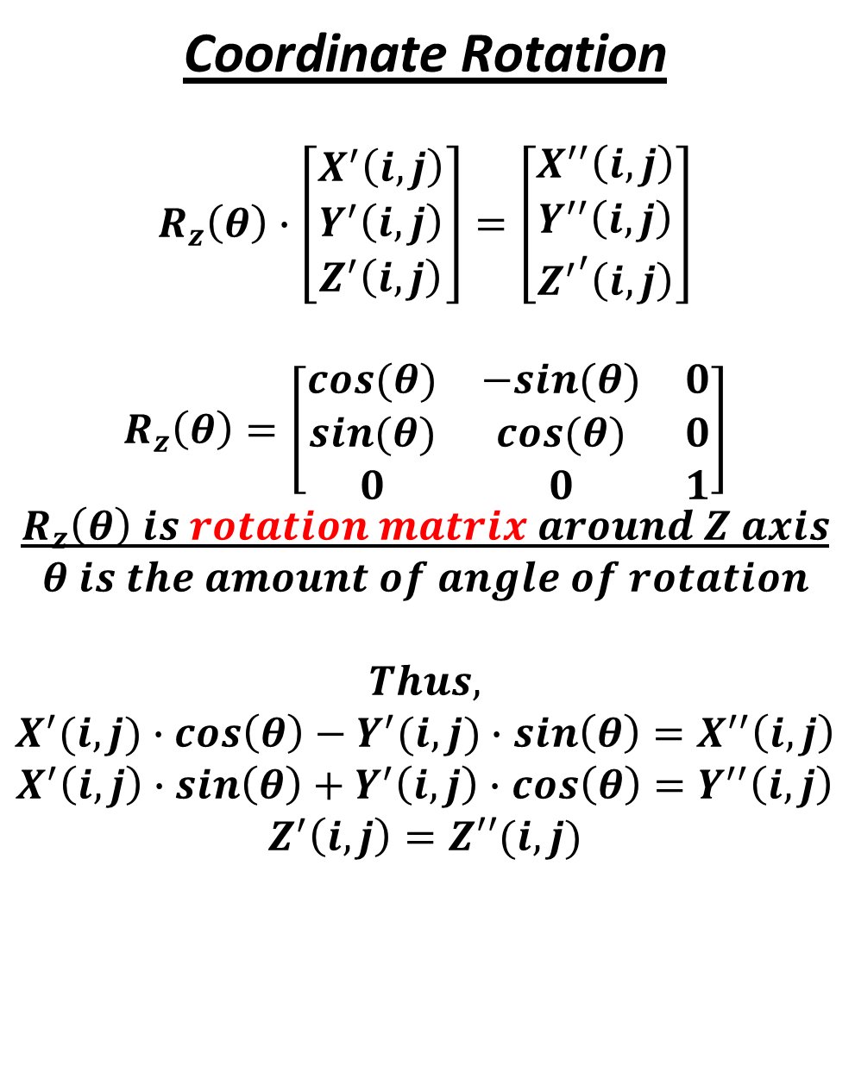
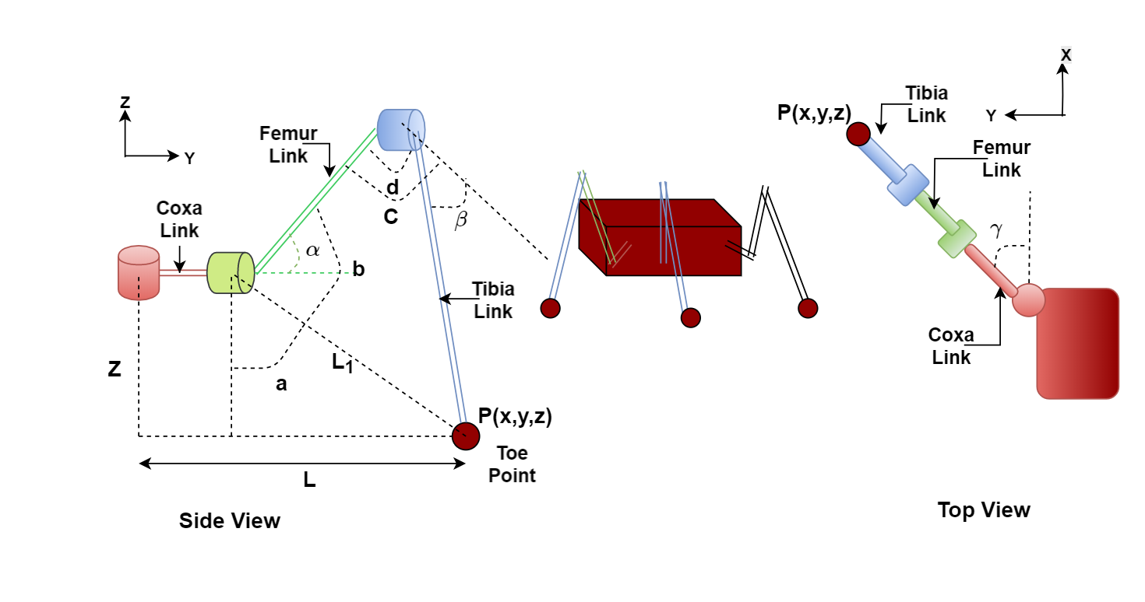
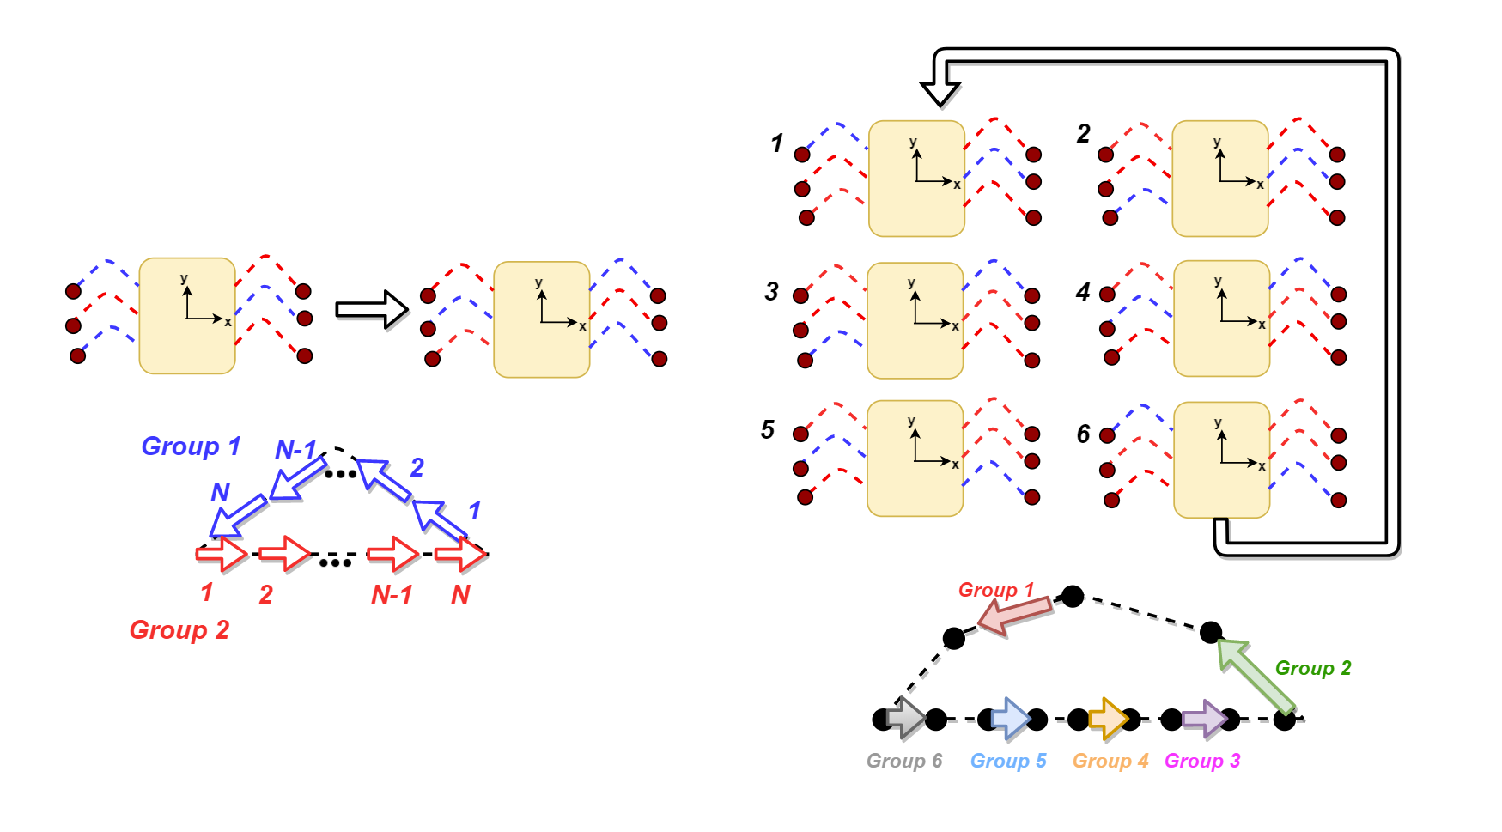
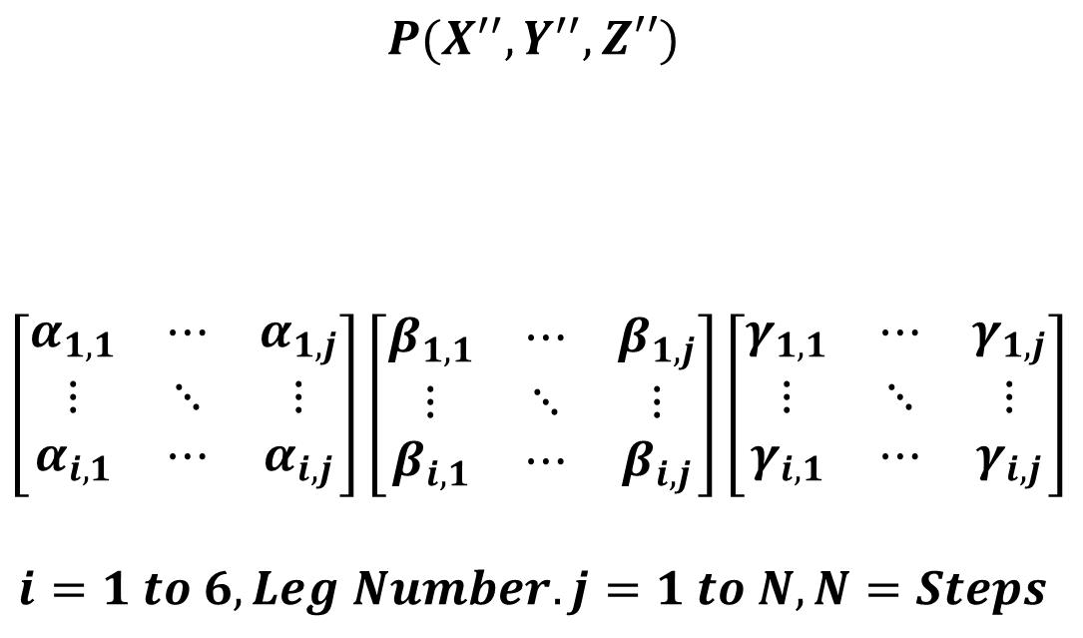
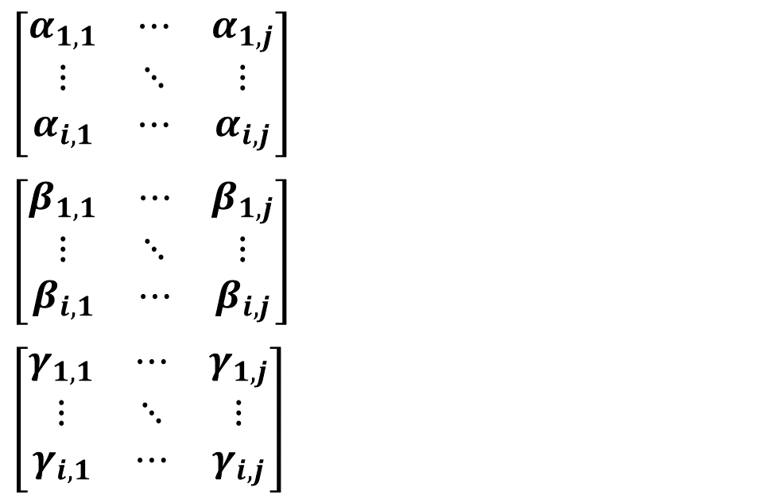
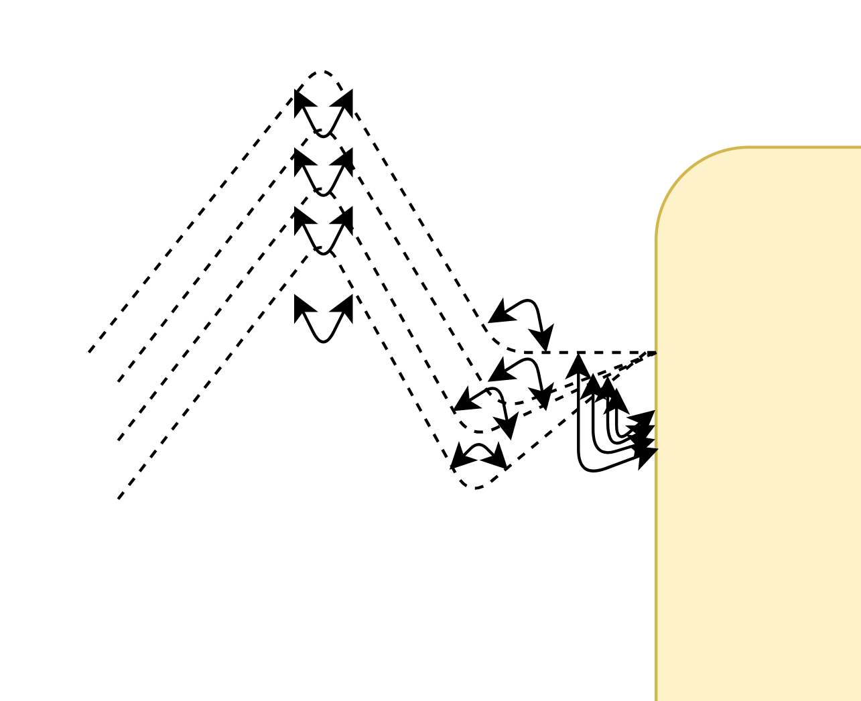
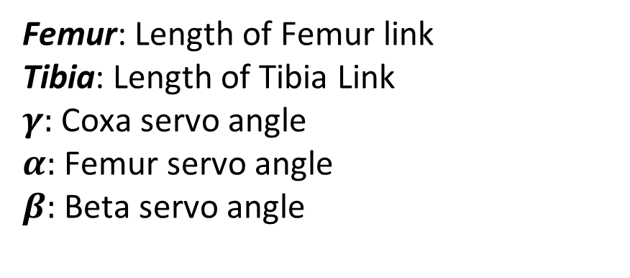
A Multi-gait Remote-controlled Hexapod Educational Platform
Author: Yongxin Guo
Mentor: Prof. Anurag Purwar
Department: Stony Brook University Mechanical Engineering Department
Abstract
The topic of multi-DOF (Degree of freedom) robotics has been pervasively studied and explored due to its immense potential in space exploration, nuclear power plant operation and rescue, military carriage and etc. The popularity of multi-legged robot has reached its apogee in recent years along with the emergence of several remarkable robotic products developed by Boston Dynamics, a unicorn company that mainly deals with multi-legged robotics. A highly flexible hexapod (six-legged robot) platform has been designed in the Computer Aided Design Innovation and Engineering lab using SnappyXO kits developed by Prof. Anurag Purwar. The objective of this project is intended to offer students and teenagers a general low-cost solution of designing a complex hexapod platform for education purpose. The hexapod platform incorporates multi-gait locomotion, precise control based on inversed kinematics, omnidirectional navigation function using instantaneous center of curvature method, self-developed Bluetooth remote-controlled function and etc.
Inversed Kinematics Equations
Navigation: Instantaneous Center of Curvature
After mastering the method of approaching to a desired exact coordinate in the space, next thing is to determine which direction the coordinates of the toes should location and lay out. The hexapod platform should have a effective solution to be able to maneuver toward any direction and even walk along a curve line not just along a straight line. The completely flexible omnidirectional ability is achieved by using a method called “Instantaneous Center of Curvature”, so-called “ICC” method. By inputting a selected point in the working plane of the hexapod, six arc lines can be drawn out around this selected point and pass through the toes of six legs at the same time. In this way, six paths of going toward a desired straight or curvy direction is presented well for six legs. As a result, the center of the body will travel along an arc that passes through itself and is made by circling around the ICC point. However, the way people control the direction of the hexapod using joystick actually transmit a point that is offset by 90 degrees clockwise away from ICC. Thus, rotation matrix is needed here to rotate the point of direction sent from users by 90 degrees counter-clockwise, then the point will be the correct ICC Point.
Input
Output
P(X,Y,Z)
How to walk along a straight line?
The hexapod can travel along any straight direction if the ICC point is place at a infinite distance away from the center of body. In real coding situation, a large value of distance can be selected (e.g., “2000 cm”)
Building Blocks of Robotics
Transform Coordinates: Rotation Matrix
The inversed kinematics equations were carried out and implemented based on the coordinates at the frame of the Coxa servo. However, it is not intuitive to describe the coordinates of toe respect to the frame of Coxa servo. The coordinates are actually expressed in terms of the body center. Hence, a series of coordinates transformation and coordinates rotation will be carried out for all of the six legs in order to convert the toe coordinates respect to body center to Coxa servo.
ICC Point
Go forward
Go Right
ICC
(0,+Inf)
C.o.B
ICC
(-Inf,0)
A reliable precise position control is critical for the task implementation of a robot. In a robotic system, servos serve as the joints for the robotics to manipulate its variant components such as arms, legs and the head. It is intuitive to imagine the physical block of servo as a mathematical function that outputs a coordinate position by feeding it a value of angle as input, which is called “forward kinematics”. The output coordinates will vary as the length of link attached to the servo varies. Normally, a series of servos and links can be called “open-loop kinematics chain”. However, in any given scenario, the task will always involve moving a end effector to a desired coordinate. Then, those desired coordinates become our input for the “servo function” and the angles fed into servos become our outputs. Thus, a reverse calculation of legged trigonometry math should be performed. This is so-called inversed kinematics
Manipulation: Inversed Kinematics
How to Rotate the Hexapod
By placing the instantaneous center of curvature point at the position of the center of the body, all the six arcs passing through the six legs of the hexapod will be formed into six circles that enclose the entire body of the hexapod. Then, the legs will swing back and forth around the center of the body. In ICC method, the leg is actually swinging back and forth around the circle centering at ICC point. In this case, the body of the center is just the ICC point, hence the legs will swing around the center of the body, which can result in a rotation motion of the hexapod.
“-”
“-”
ICC
(0,0)
“-”
Tripod Gait
Ripple Gait
Multi-Gaits
The hexapod system consists of two gaits: Ripple gait and tripod gait. In the left graph, each group represents the legs moving at same time. By shifting the coordinates sequences in the matrices, different gaits can be converted into other kind of gait in the coding process.
IK algorithms
L: Leg length.
Z: Height of body lifted by leg
X: Toe position to coxa servo in x-axis
Y: Toe position to coxa servo in y-axis
Coxa: Length of Coxa link

